Slide 1
Week 1

Slide 2


Slide 3
Confusion over causality

Slide 4


Slide 5
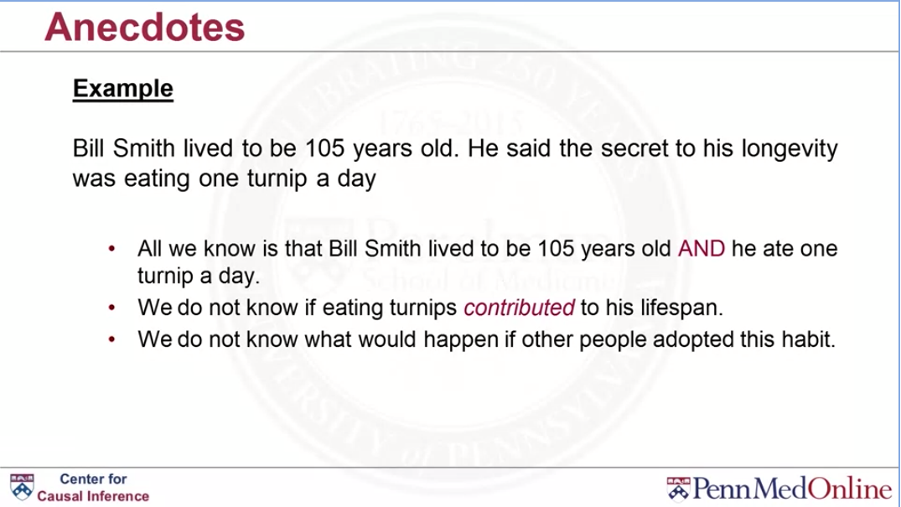

Slide 6


Slide 7


Slide 8


Slide 9


Slide 10
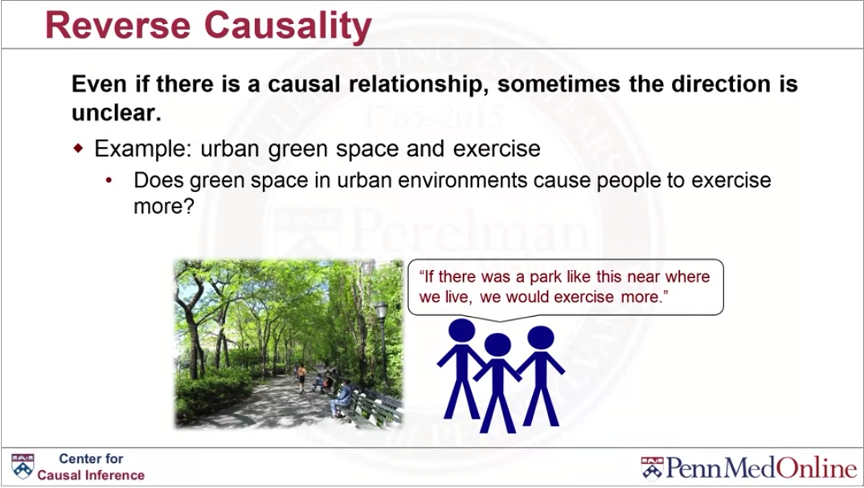

Slide 11
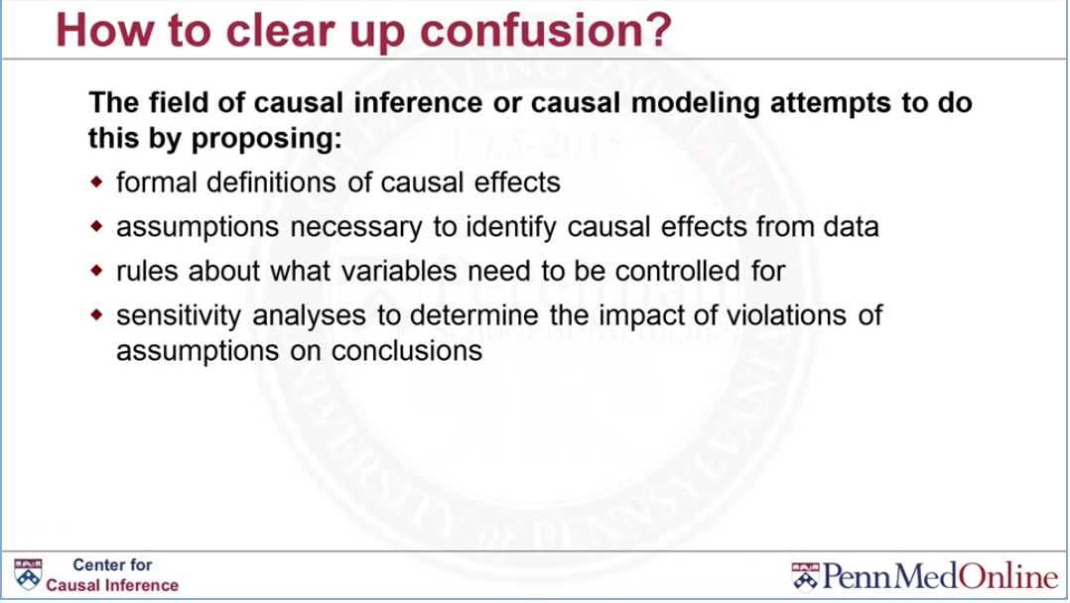

Slide 12
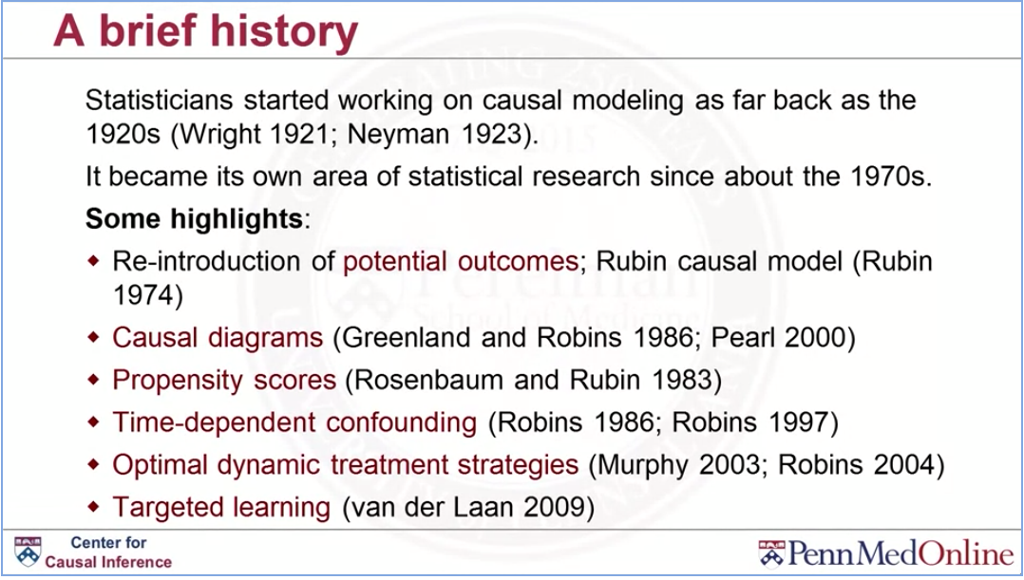

Slide 13
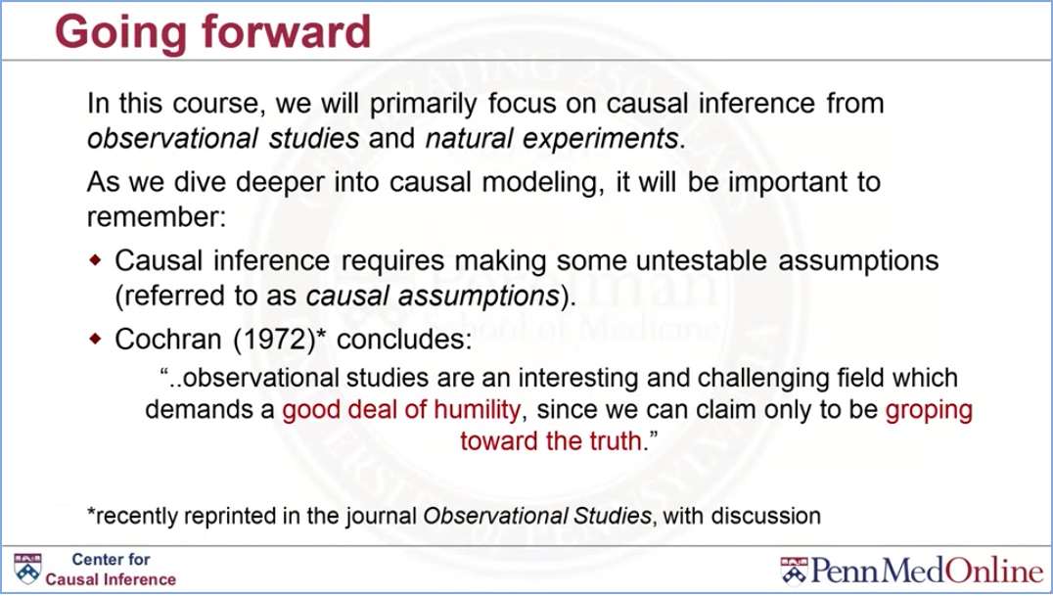

Slide 14
Potential outcomes and counterfactuals

Slide 15
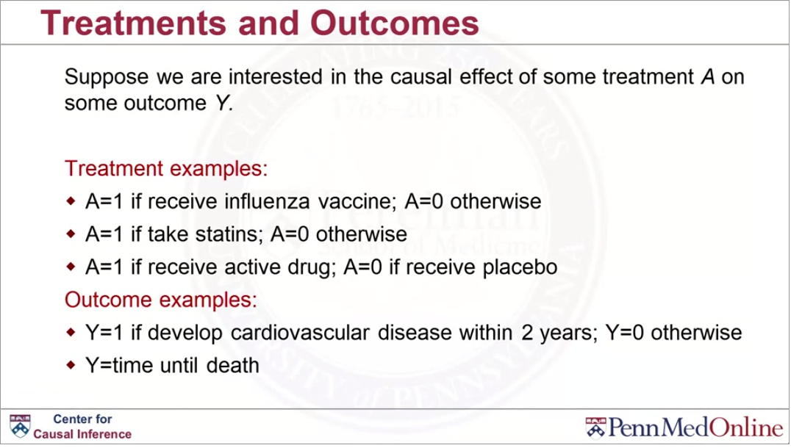

Slide 16
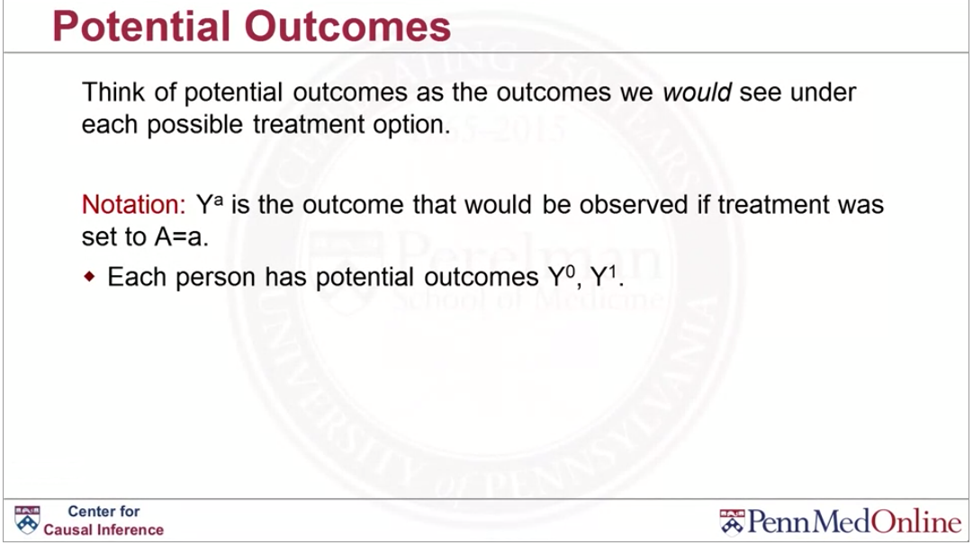

Slide 17
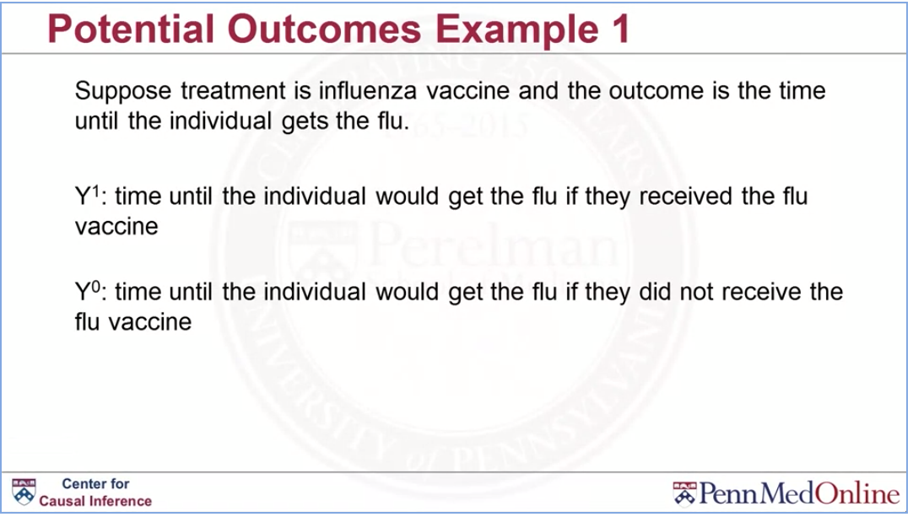

Slide 18
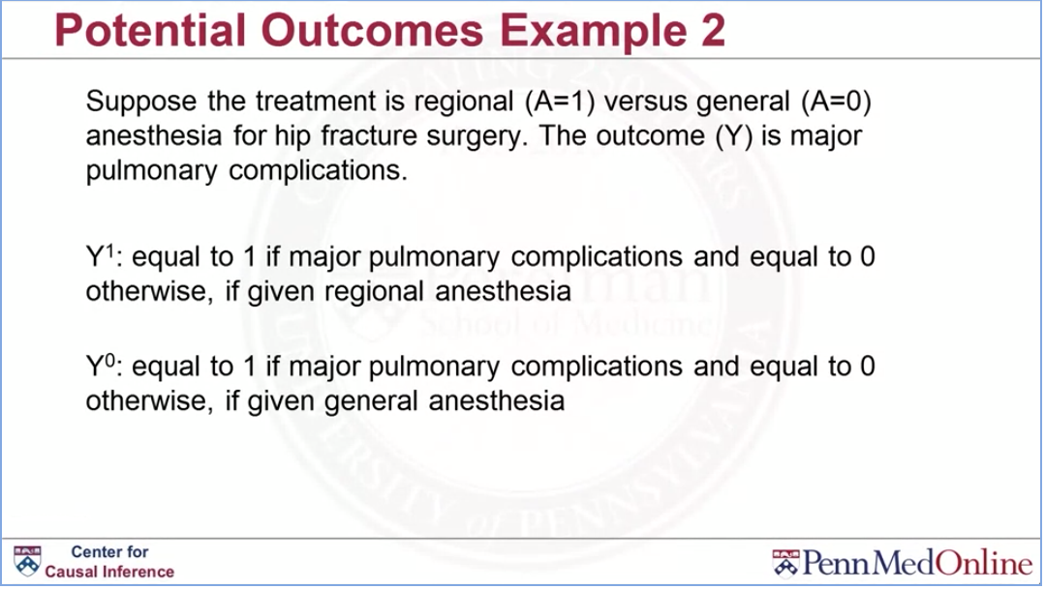

Slide 19
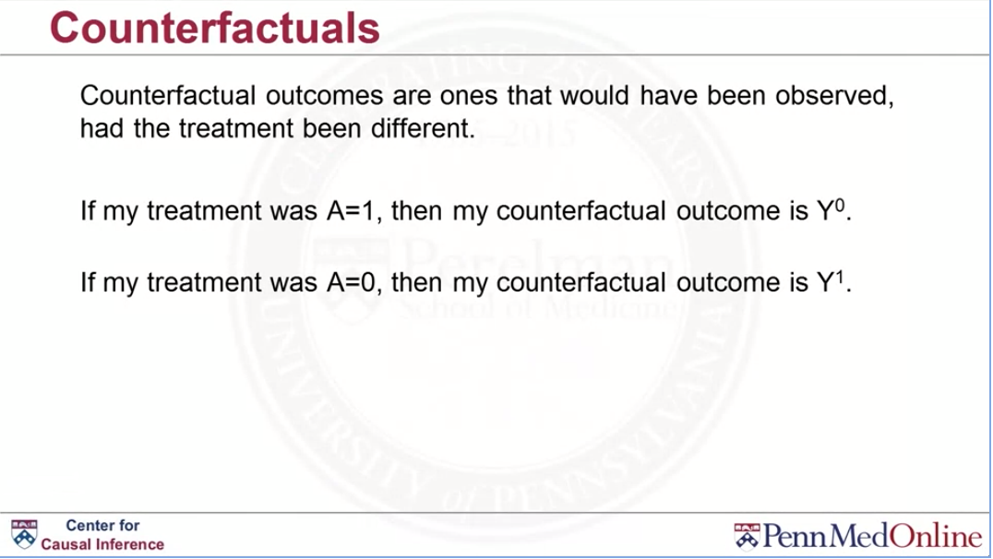

Slide 20
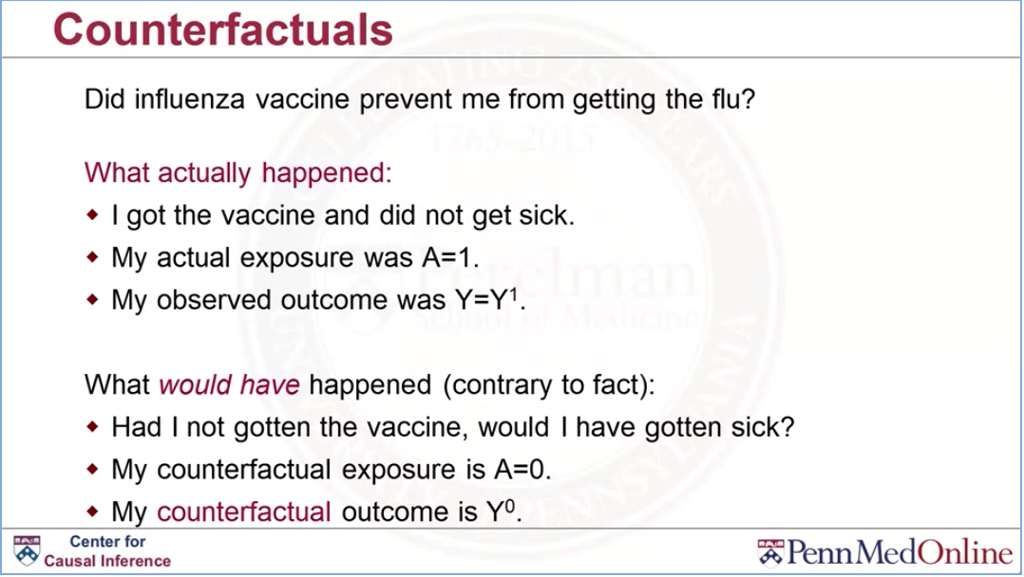

Slide 21
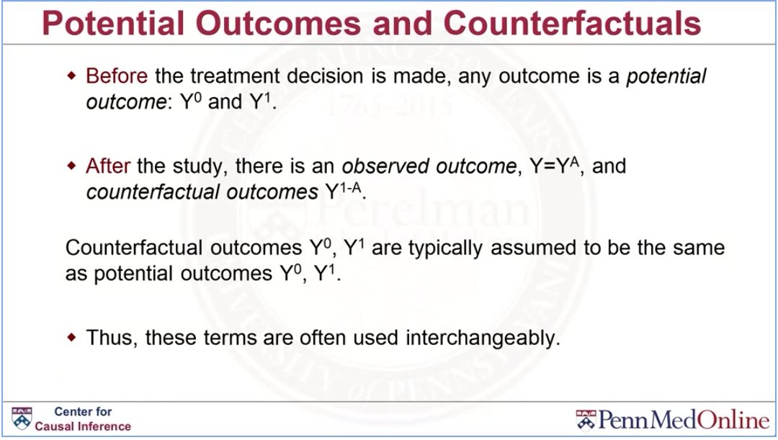

Slide 22
Hypothetical Interventions

Slide 23
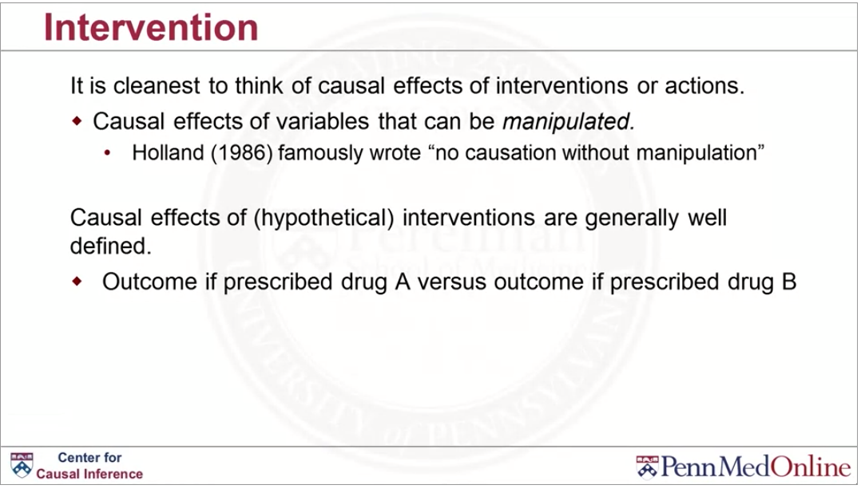

Slide 24
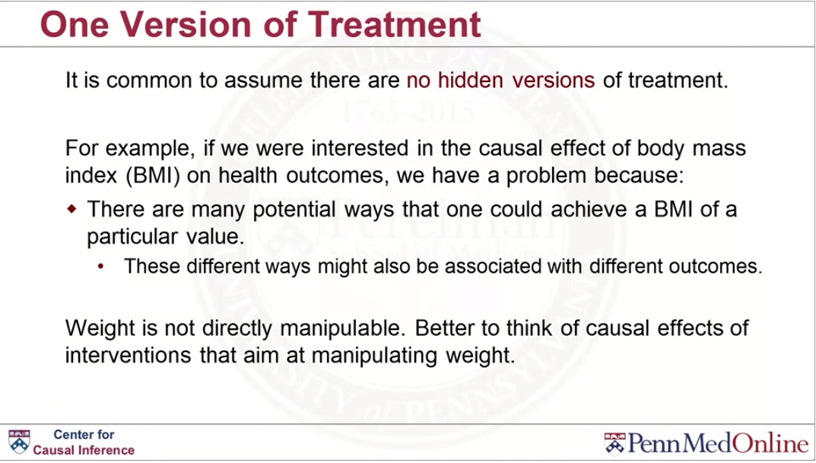

Slide 25
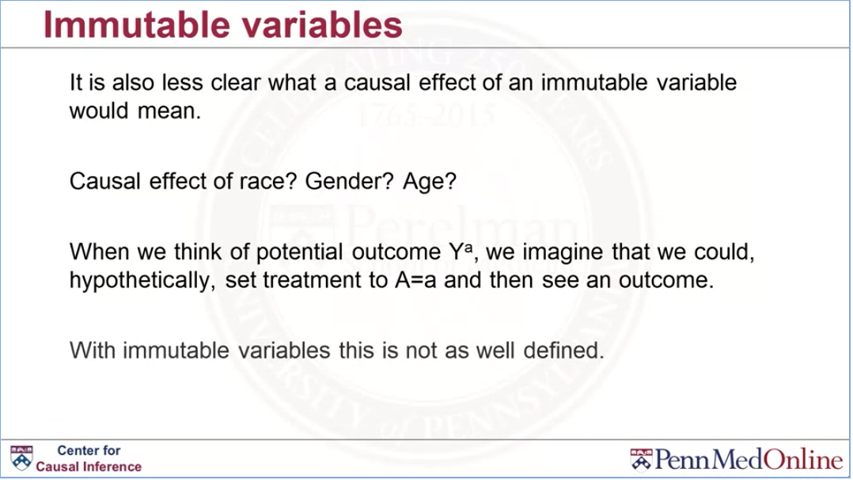

Slide 26
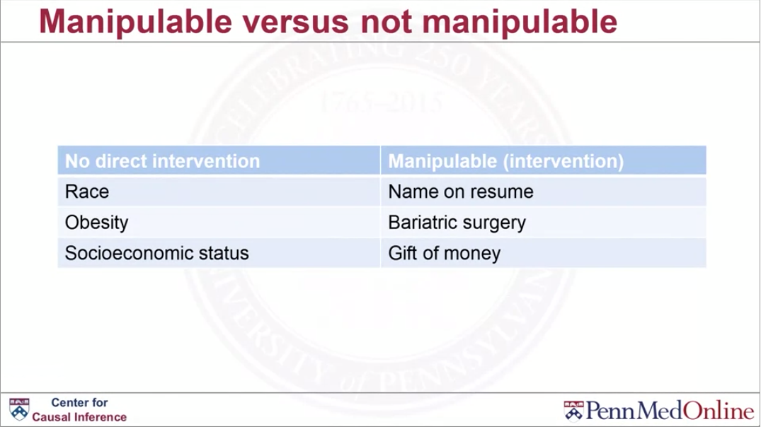

Slide 27
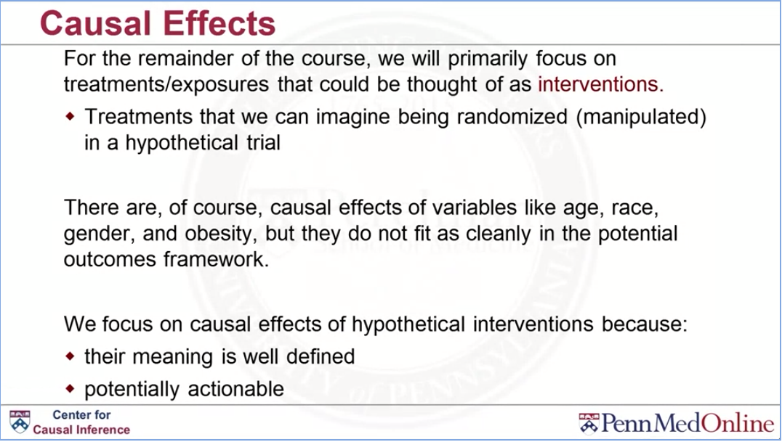

Slide 28
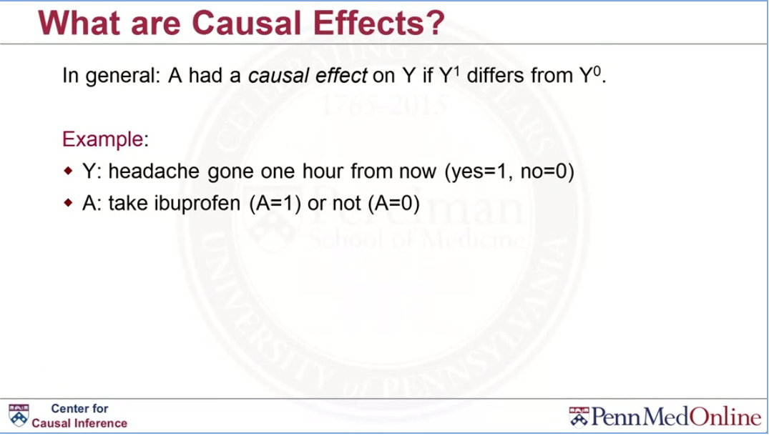

Slide 29
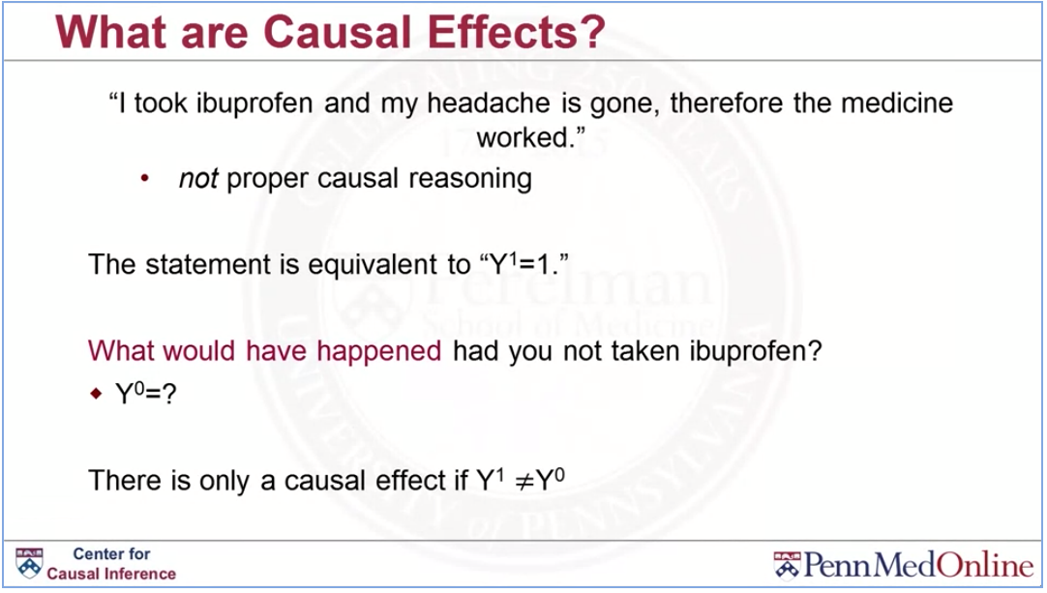

Slide 30
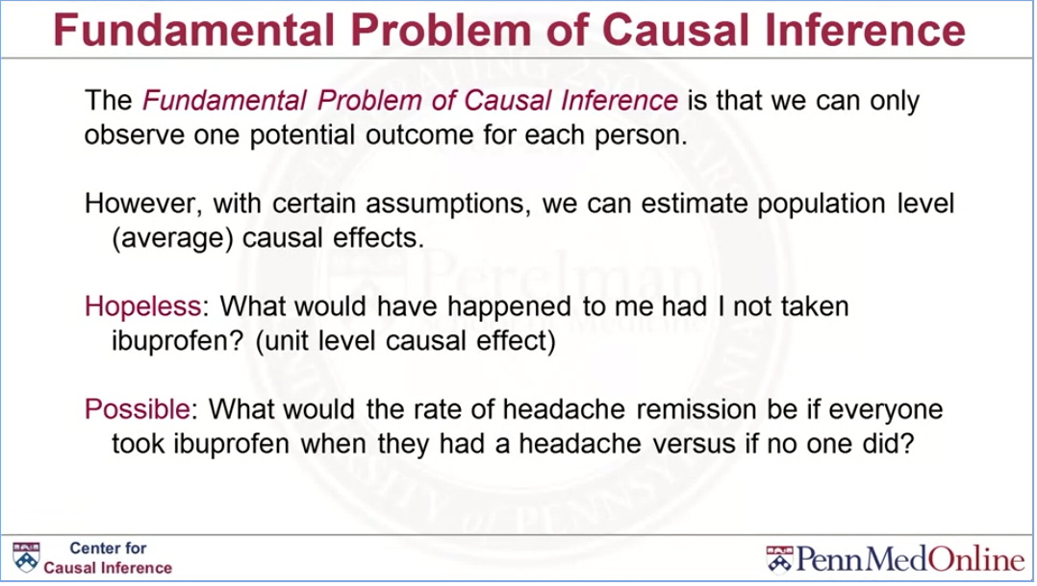

Slide 31
Causal Effects

Slide 32
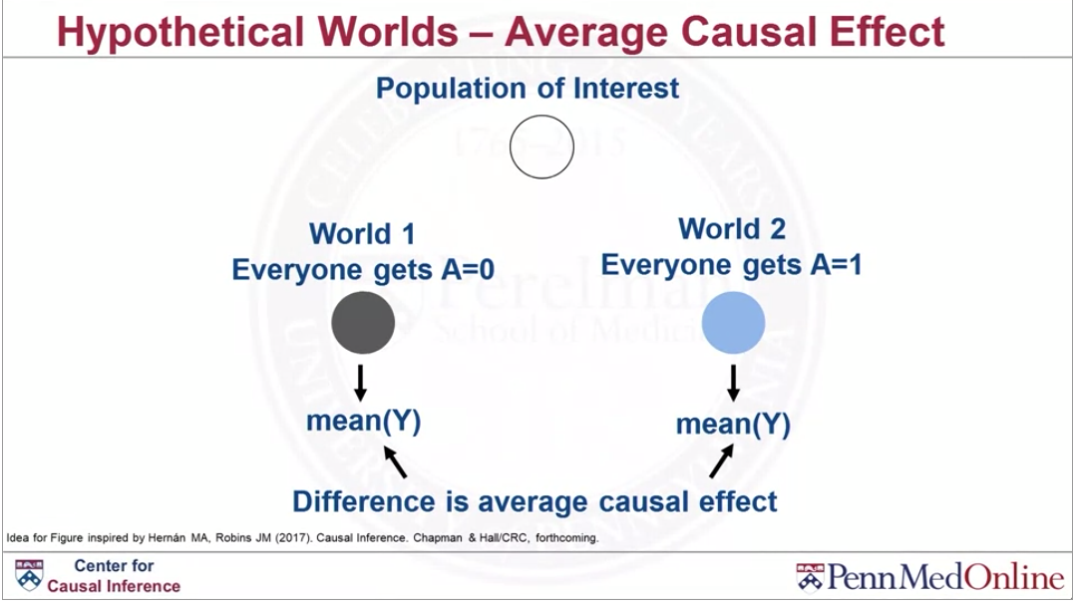

Slide 33
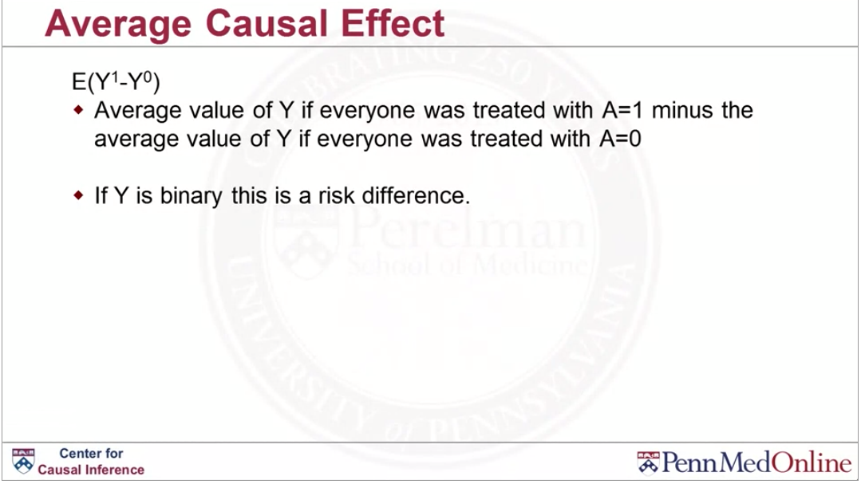

Slide 34
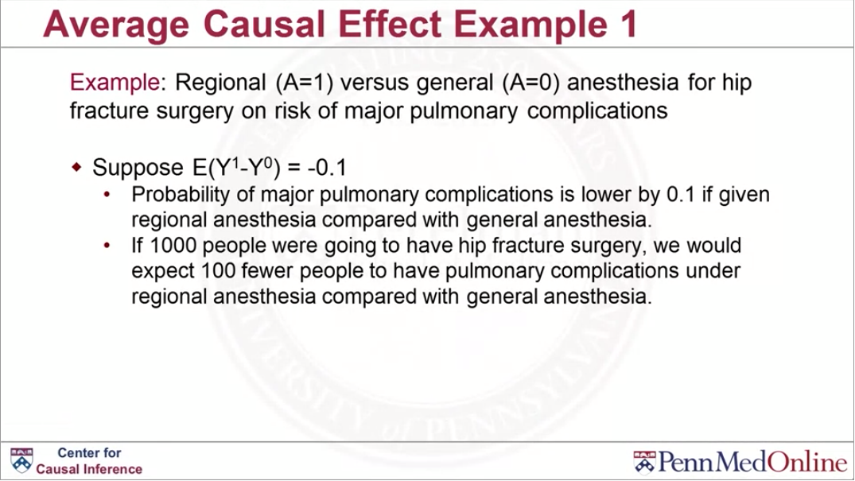

Slide 35
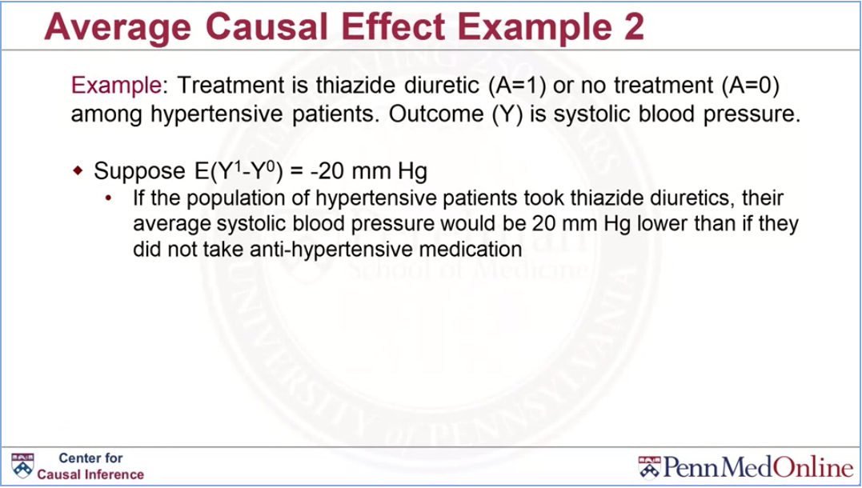

Slide 36
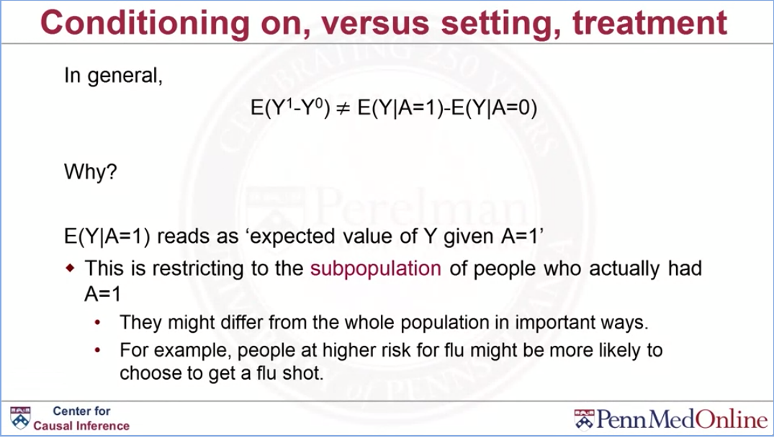

Slide 37
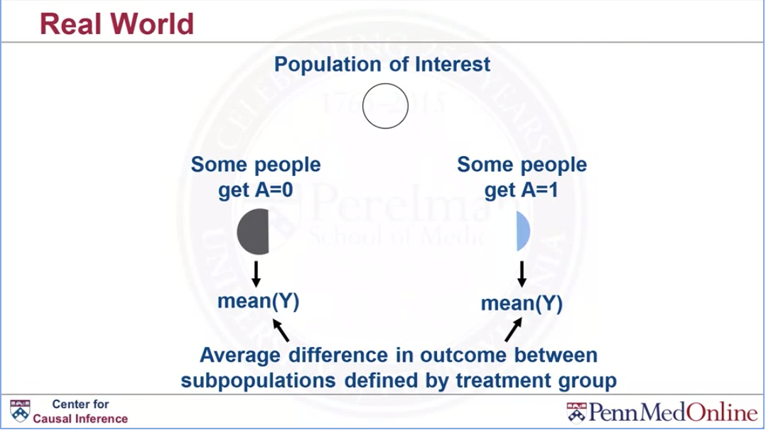

Slide 38
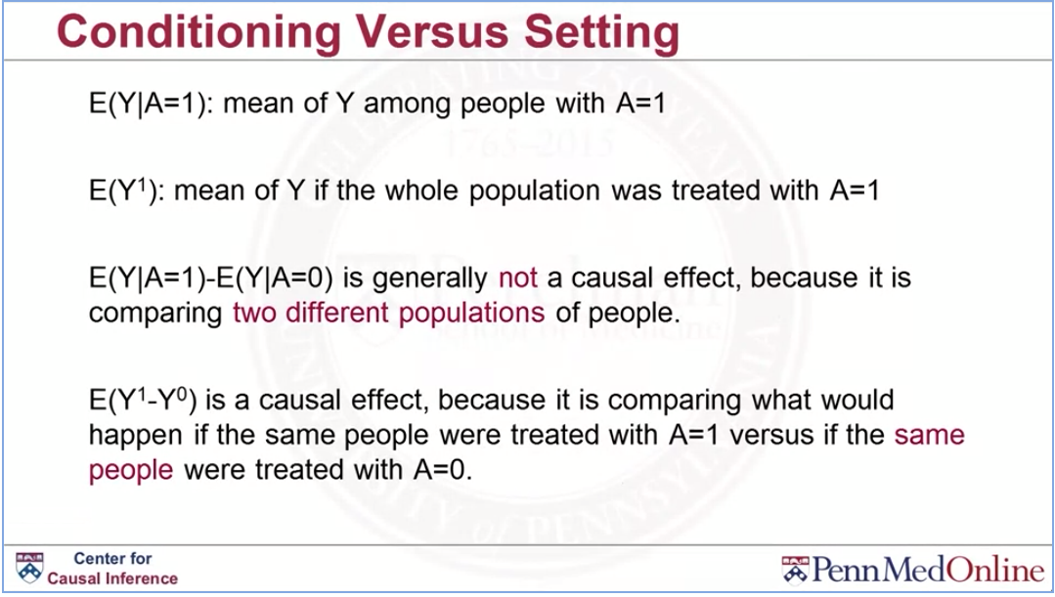

Slide 39
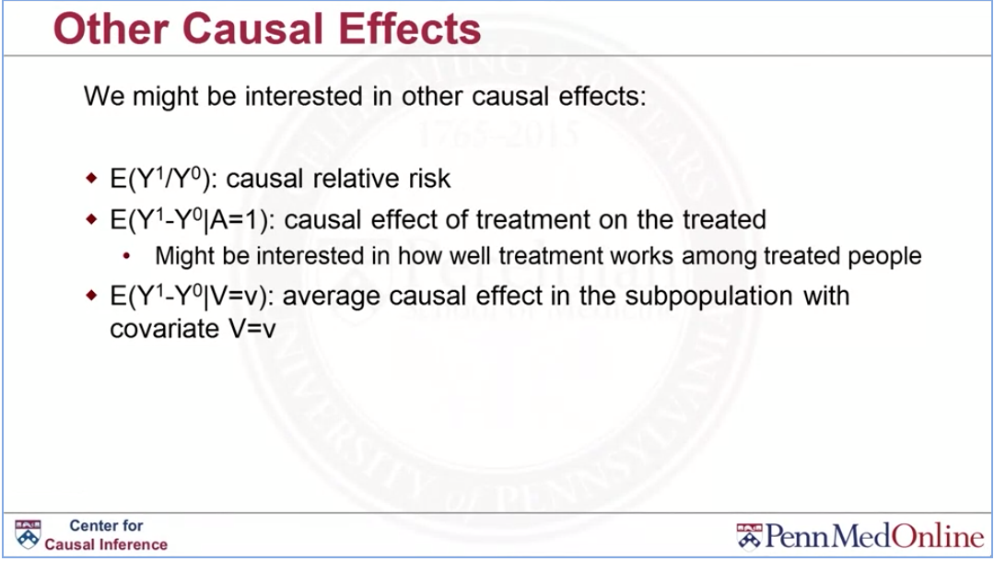

Slide 40
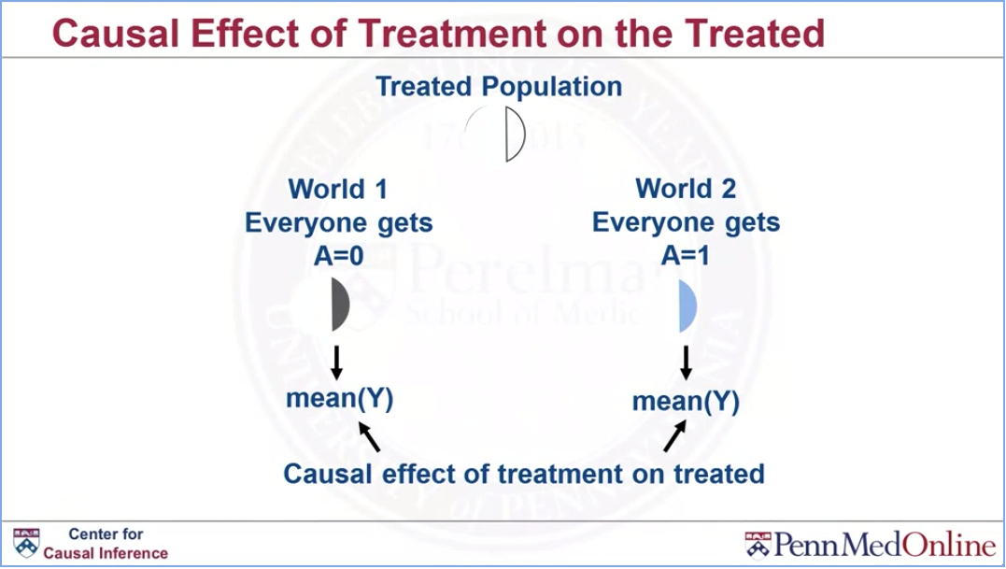

Slide 41
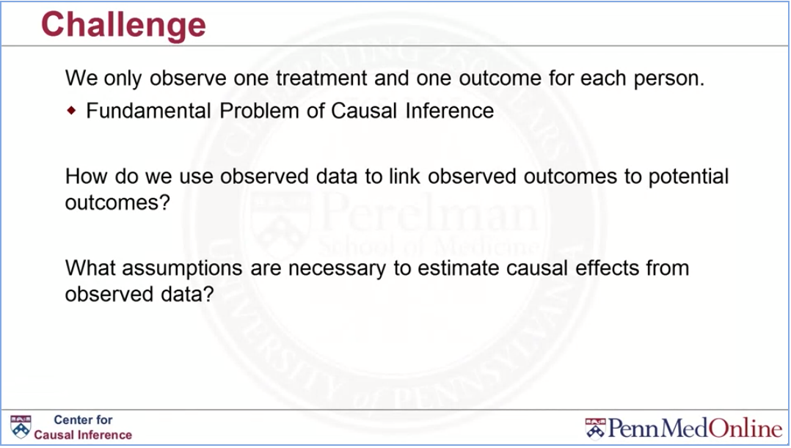

Slide 42
1. Which of the following represents what the average outcome would have been had no one been treated?
E(Y^0)
2. We only can observe one potential outcome for each person is
the Fundamental Problem of Causal Inference

Slide 43
Causal assumptions

Slide 44
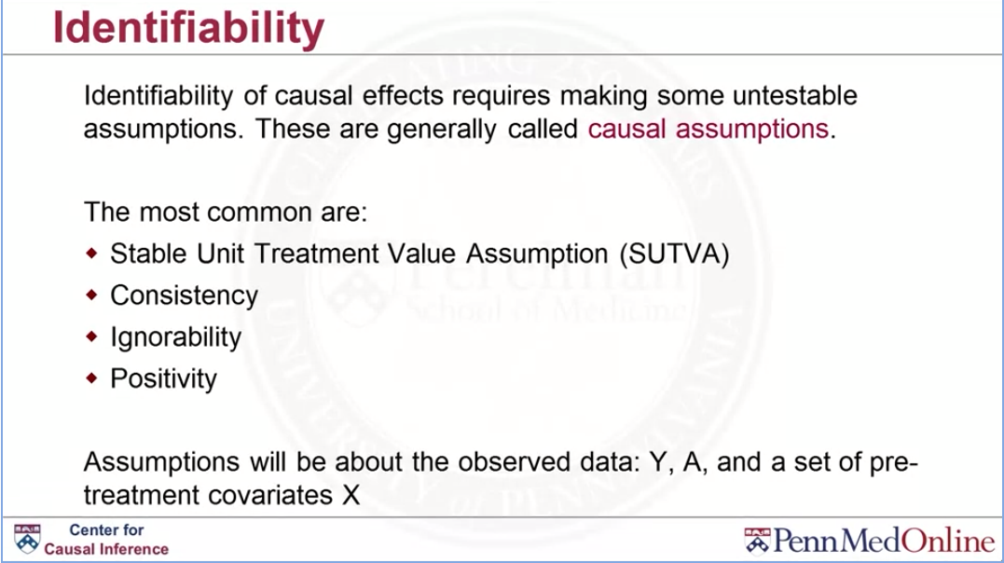

Slide 45
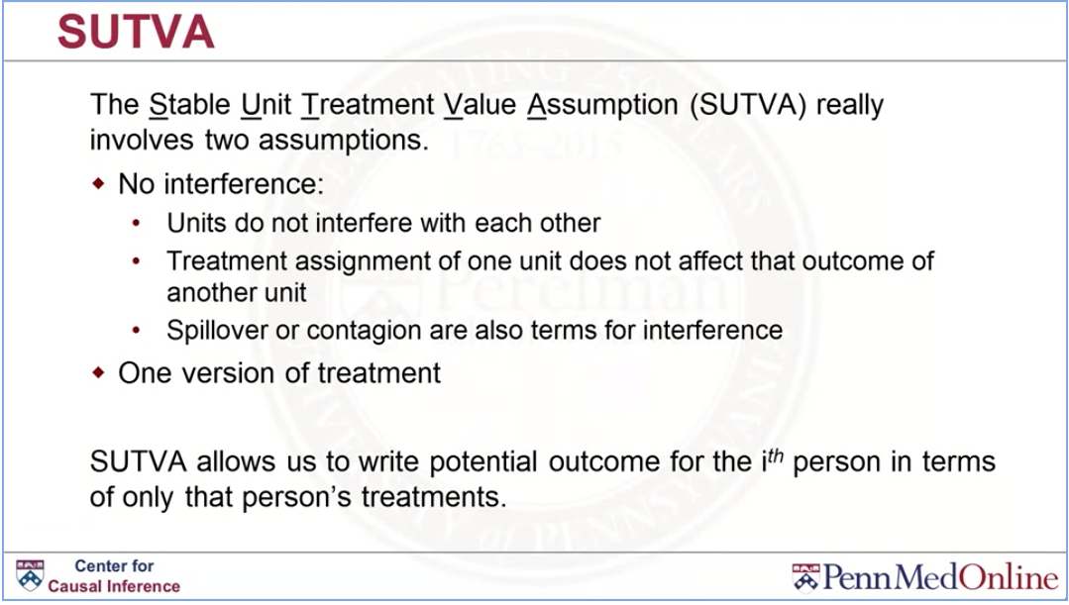

Slide 46
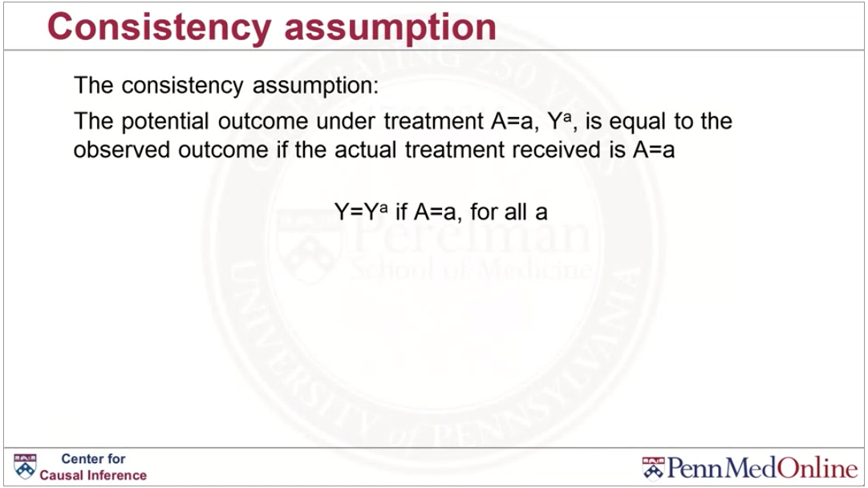

Slide 47
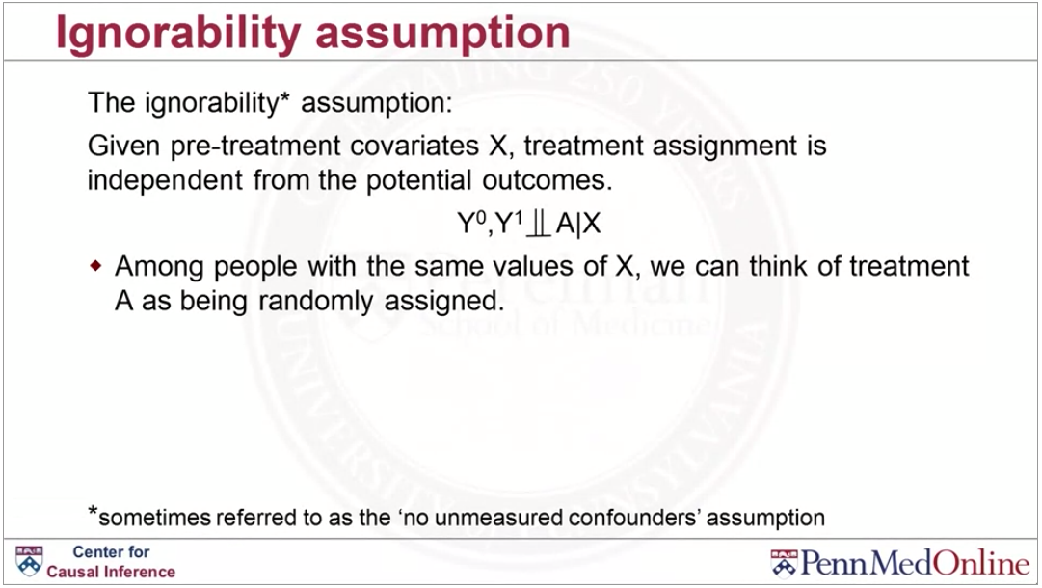

Slide 48
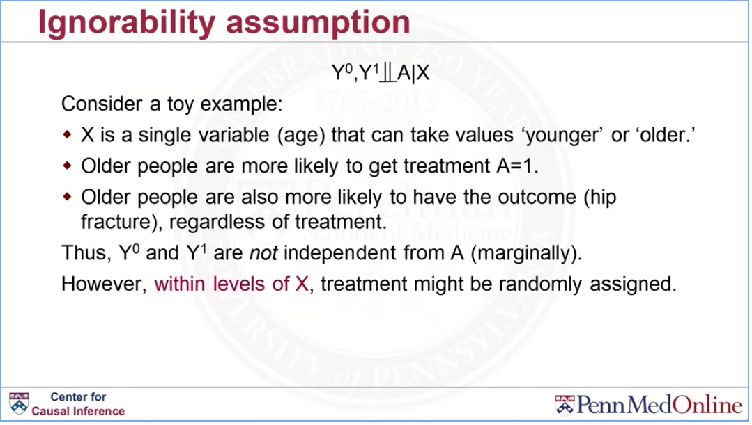

Slide 49
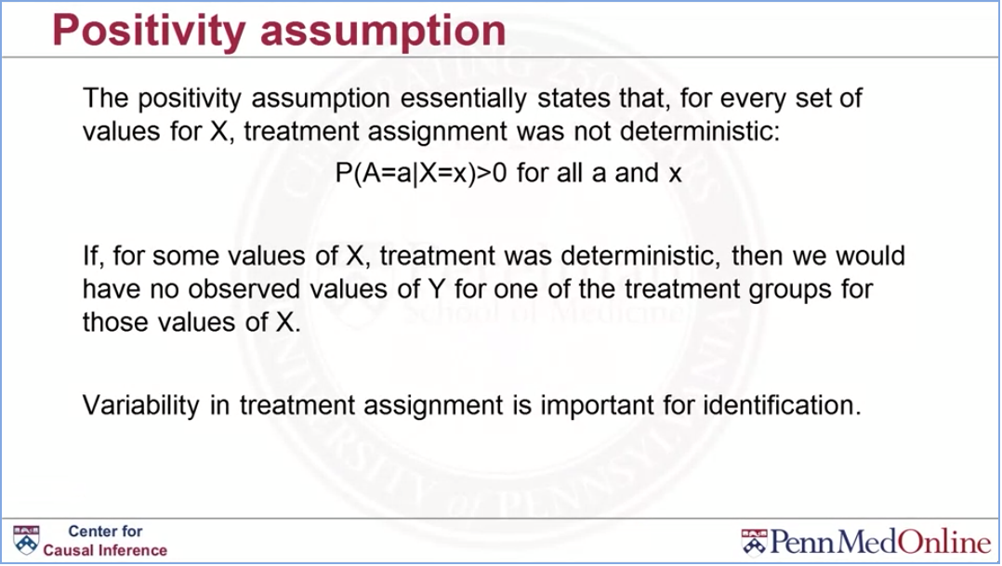

Slide 50
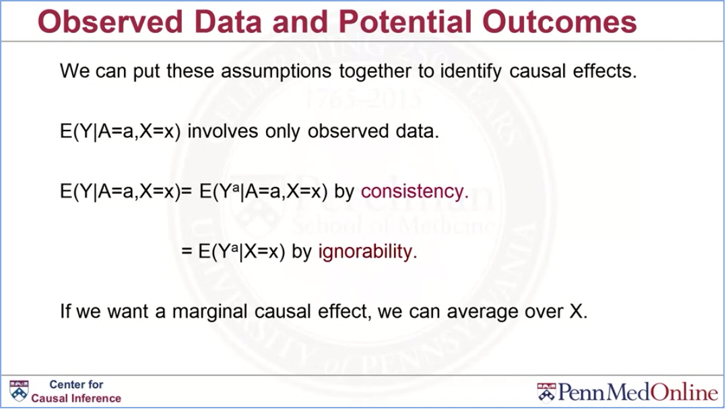

Slide 51
Stratification

Slide 52
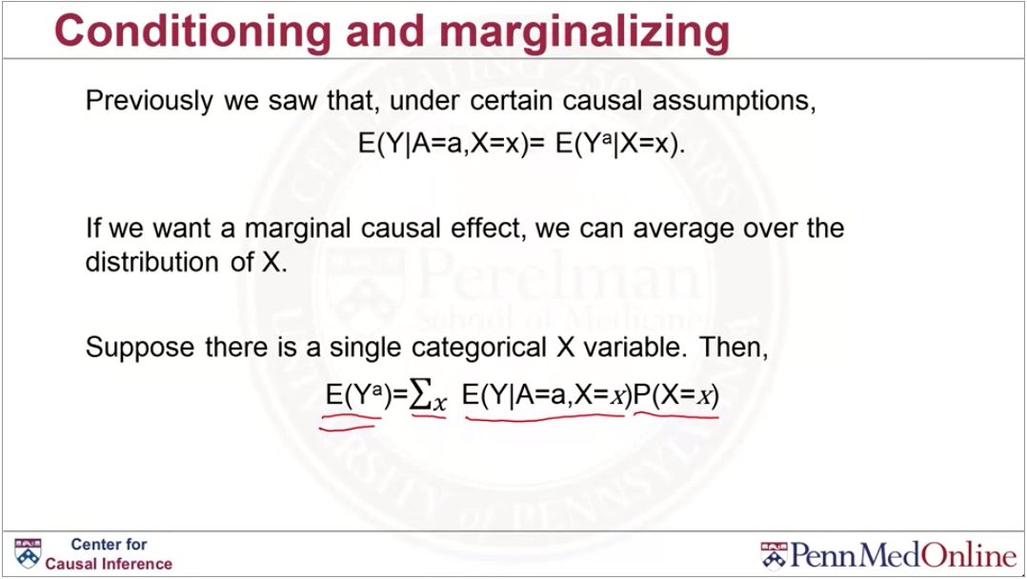

Slide 53
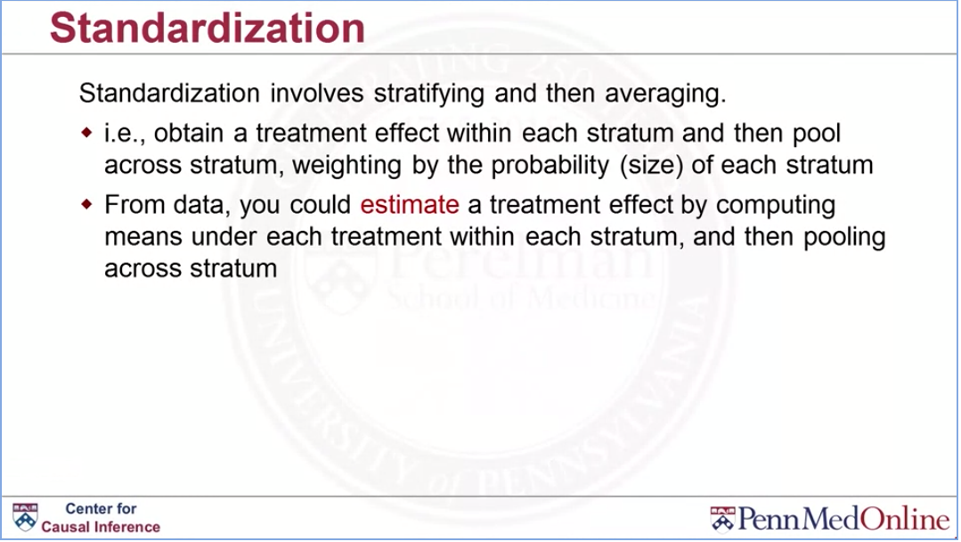

Slide 54
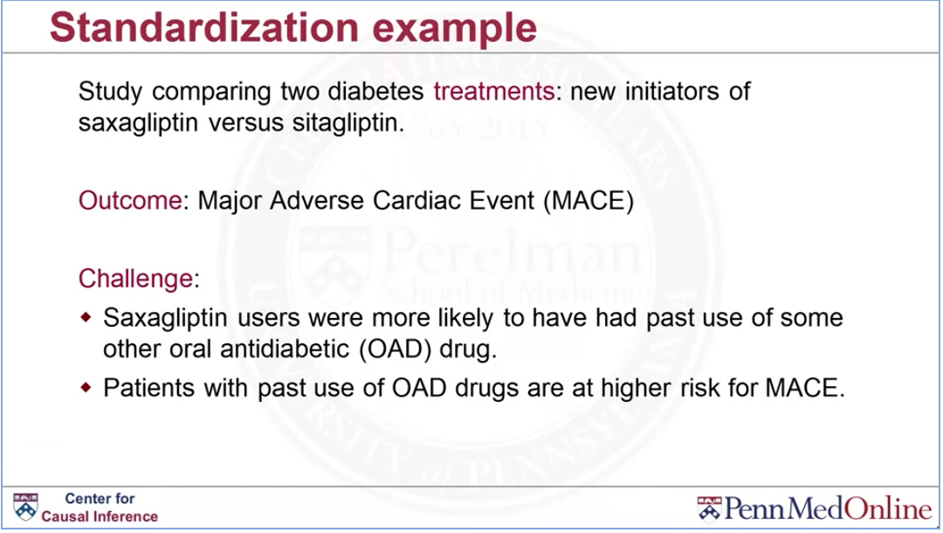

Slide 55
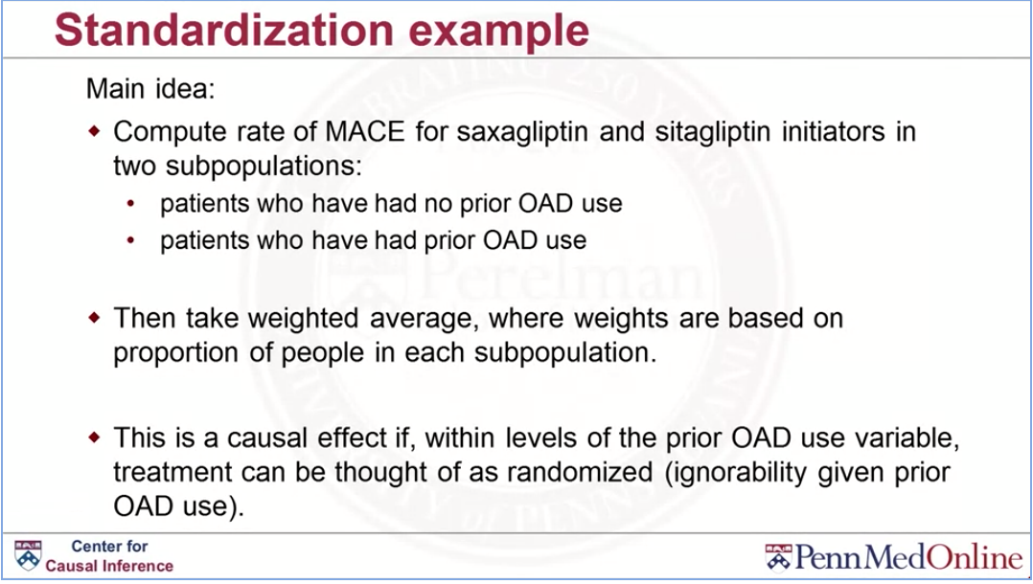

Slide 56
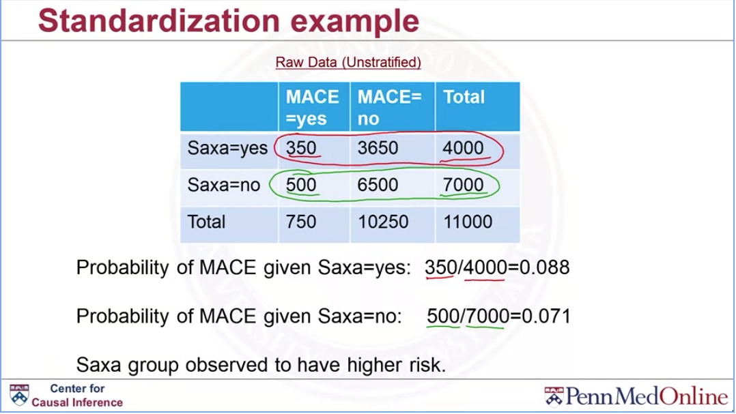

Slide 57
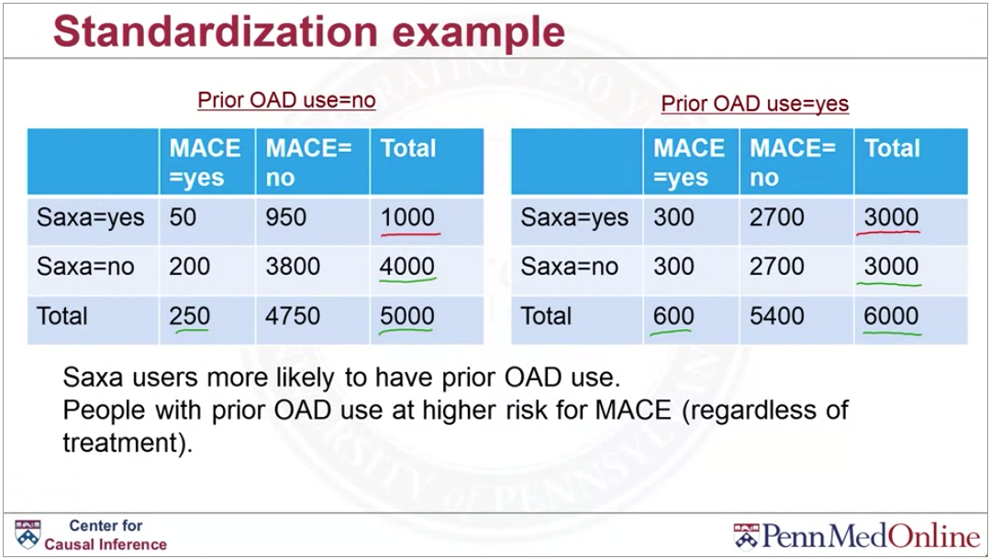

Slide 58
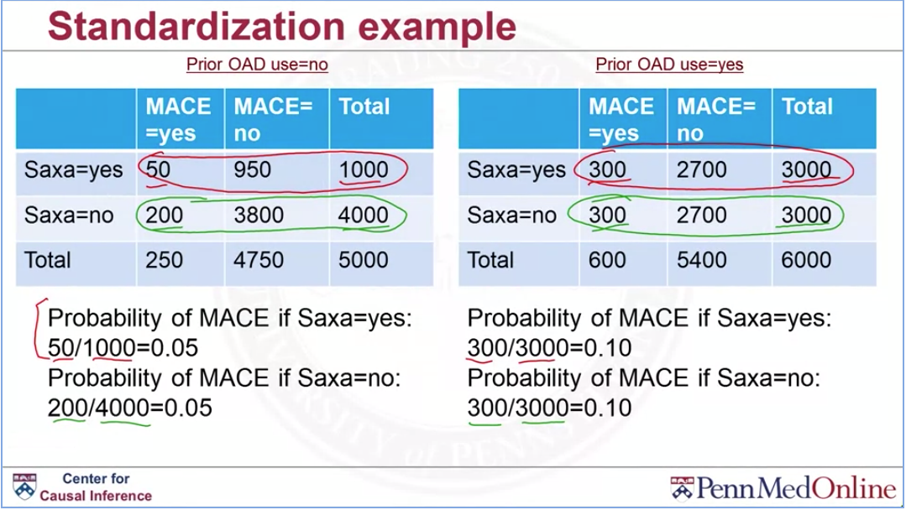

Slide 59
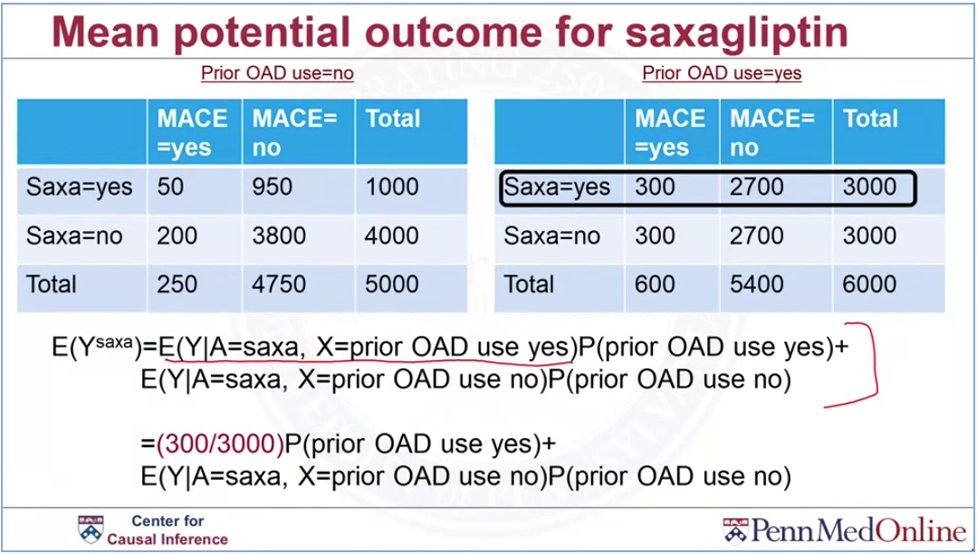

Slide 60
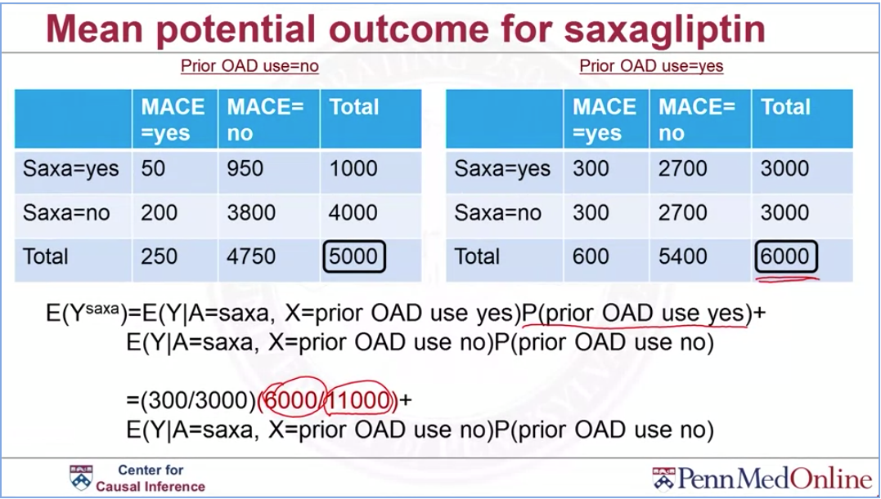

Slide 61
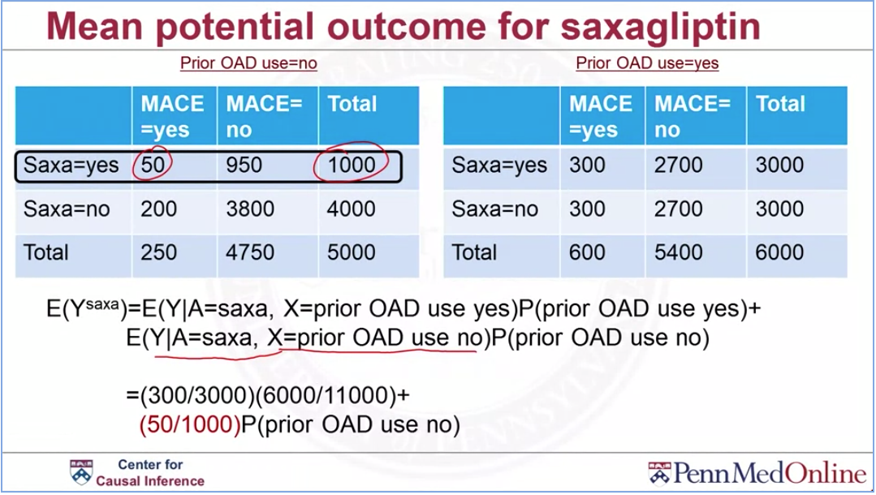

Slide 62
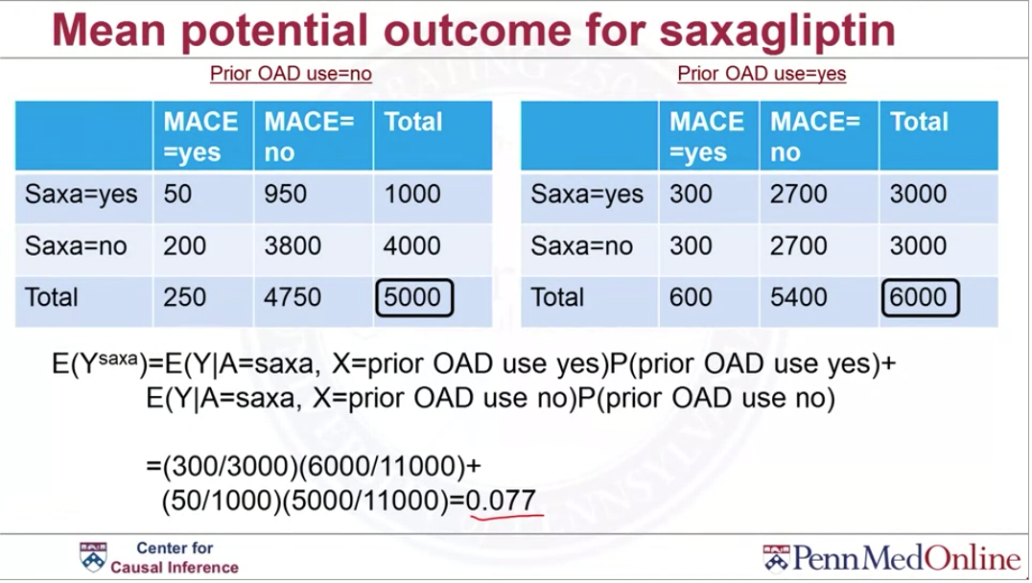

Slide 63
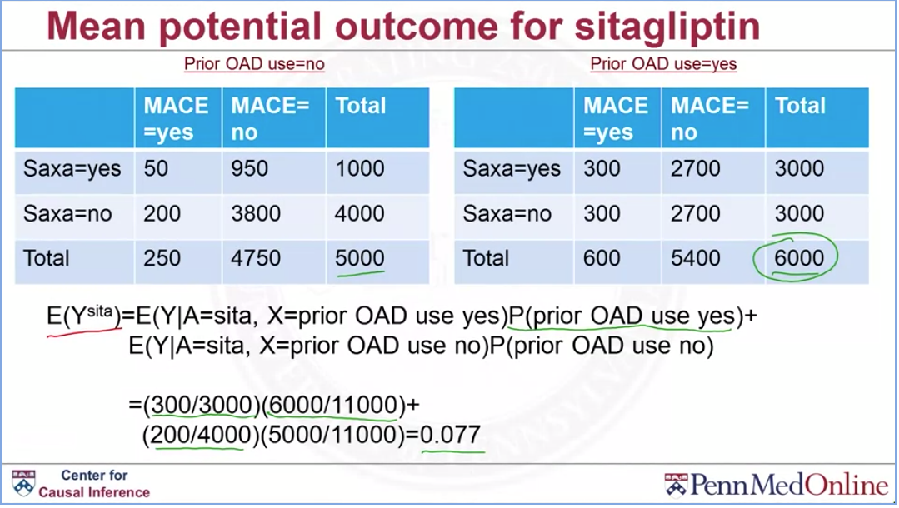

Slide 64
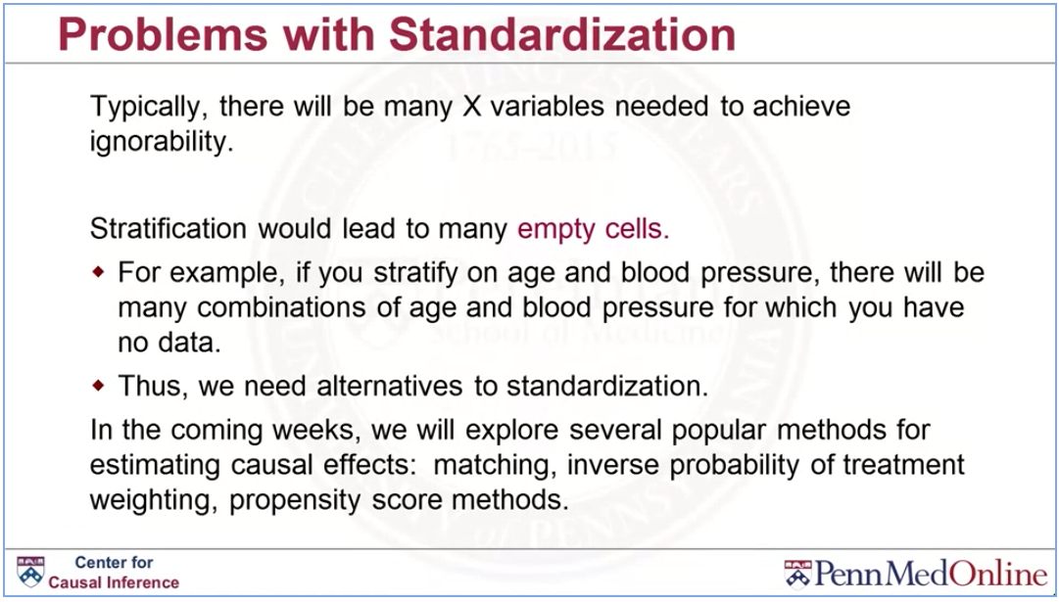

Slide 65
1. Which assumption is also referred to as the ‘no unmeasured confounders’ assumption?
Ignobility
2. Which causal assumption requires that there is no interference between units?
SUTVA

Slide 66
Incidence user and active comparator designs

Slide 67


Slide 68


Slide 69


Slide 70


Slide 71


Slide 72


Slide 73


Slide 74


Slide 75
1. The fundamental problem of causal inference is that?
we can only observe one potential outcome for each subject
2. Which of the following represents the causal effect of treatment on the treated?
E(Y^1|A=1)-E(Y^0|A=1)
3. Which of the following represents the average causal effect for the population?
E(Y1)-E(Y0)
4. Which assumption would be violated if the effectiveness of treatment on an individual dependent on the treatment status of individuals?
SUTVA

Slide 76
5. Which assumption would be violated if we were interested in the causal effect of treatment for people age 40-80, but everyone over age 70 received the treatment?
Consistency NOOOOO
6. If the consistency assumption holds, then the observed outcome for a treated subjected is equal to their potential outcome under that treatment.
TRUE

Slide 77
7. Which of the following can most easily be thought of as an intervention?
Changing medication
8. Treatment assignment being ignorable given confounders, X, means:
Within levels of X, treatment assignment is independent from the potential outcomes.
9. Computing means within levels of covariates and then combining these estimates is known as
standardization

